Slide 1

CS 7081 Advanced Algorithms
Final Project
Team 01
Christopher Broderick,
Rohit Dureja,
Akash Mohapatra,
Bill Nicholson,
Asrith Singa Reddy.
[1]

Slide 2
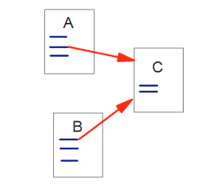
Page Rank
[2]

Slide 3
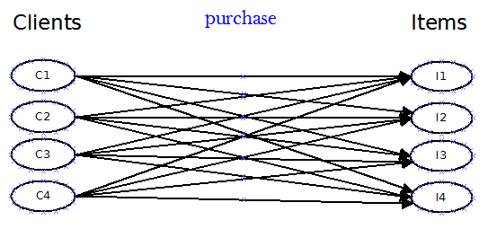
Apply Page Rank to
Every Client has purchased every Item
Bipartite Unweighted Directed Graph
These ‘links’ are organic: clients link to items by purchasing them.
There are no links from Items to Clients!

Slide 4
Transition Matrix from Previous Slide
 | I1 | I2 | I3 | I4 | C1 | C2 | C3 | C4
I1 | 0 | 0 | 0 | 0 | 0.25 | 0.25 | 0.25 | 0.25
I2 | 0 | 0 | 0 | 0 | 0.25 | 0.25 | 0.25 | 0.25
I3 | 0 | 0 | 0 | 0 | 0.25 | 0.25 | 0.25 | 0.25
I4 | 0 | 0 | 0 | 0 | 0.25 | 0.25 | 0.25 | 0.25
C1 | 0 | 0 | 0 | 0 | 0 | 0 | 0 | 0
C2 | 0 | 0 | 0 | 0 | 0 | 0 | 0 | 0
C3 | 0 | 0 | 0 | 0 | 0 | 0 | 0 | 0
C4 | 0 | 0 | 0 | 0 | 0 | 0 | 0 | 0

Slide 5

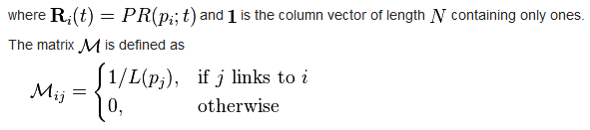
Page Rank: compute the ranking vector

Slide 6
Compute the ranking vector
After 20 iterations: final state of the Ranking Vector:
I1 0.12219
I2 0.12219
I3 0.12219
I4 0.12219
C1 0.10625
C2 0.10625
C3 0.10625
C4 0.10625
(Damping Factor of .85 allows the unlinked nodes to earn a non-zero ranking)

Slide 7
We need weights
Google’s Page Rank (probably) doesn’t use weights.
What if a Client buys >1 of the same Item?

Slide 8
Add edges to get from Items to Clients

Slide 9
Results
4 items to be processed.
4 clients to be processed.
0.000 0.000 0.000 0.000 0.533 0.067 0.476 0.095
0.000 0.000 0.000 0.000 0.267 0.133 0.238 0.190
0.000 0.000 0.000 0.000 0.133 0.267 0.190 0.238
0.000 0.000 0.000 0.000 0.067 0.533 0.095 0.476
0.381 0.267 0.133 0.048 0.000 0.000 0.000 0.000
0.048 0.133 0.267 0.381 0.000 0.000 0.000 0.000
0.476 0.333 0.267 0.095 0.000 0.000 0.000 0.000
0.095 0.267 0.333 0.476 0.000 0.000 0.000 0.000
Initial state of Ranking vector:
0.12500
0.12500
0.12500
0.12500
0.12500
0.12500
0.12500
0.12500
Final state of Ranking vector:
0.14278
0.10722
0.10722
0.14278
0.10722
0.10722
0.14278
0.14278

Slide 10
The Computed Transition Matrix
 | I1 | I2 | I3 | I4 | C1 | C2 | C3 | C4
I1 | 0 | 0 | 0 | 0 | 0.533 | 0.067 | 0.476 | 0.095
I2 | 0 | 0 | 0 | 0 | 0.267 | 0.133 | 0.238 | 0.19
I3 | 0 | 0 | 0 | 0 | 0.133 | 0.267 | 0.19 | 0.238
I4 | 0 | 0 | 0 | 0 | 0.067 | 0.533 | 0.095 | 0.476
C1 | 0.381 | 0.267 | 0.133 | 0.048 | 0 | 0 | 0 | 0
C2 | 0.048 | 0.133 | 0.267 | 0.381 | 0 | 0 | 0 | 0
C3 | 0.476 | 0.333 | 0.267 | 0.095 | 0 | 0 | 0 | 0
C4 | 0.095 | 0.267 | 0.333 | 0.476 | 0 | 0 | 0 | 0

Slide 11
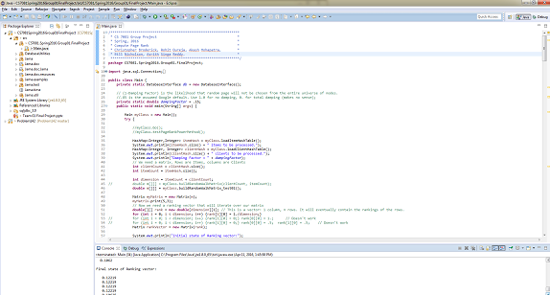
References
[1] Search.Dilbert.com
[2] Page, Lawrence, et al. "The PageRank citation ranking: bringing order to the web." (1999).
[3] http://www.ams.org/samplings/feature-column/fcarc-pagerank
[4] https://en.wikipedia.org/wiki/PageRank
Code and presentation available at https://github.com/nicomp42/CS7081Spring2016Group01FinalProject

